Slide 1
Water pH Monitoring
Under Professor Aftab Hussain
Location : Nilgiri Ground Floor Water Cooler
Medha Vempati
Fiza Husain
Harika Katta

Slide 2
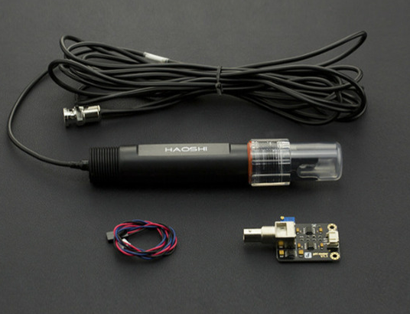
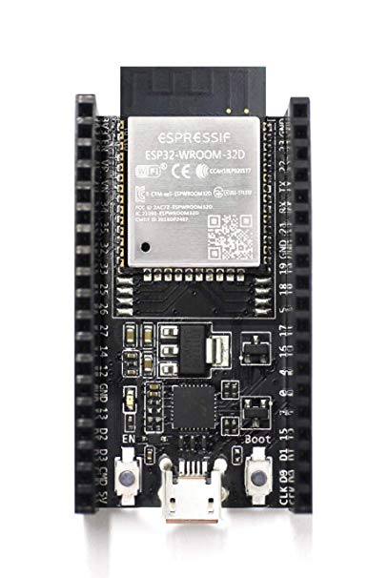

Step 1: Environment Setup
We installed the Arduino IDE, along with the packages and libraries necessary to ensure the IDE was compatible with the ESP32 microcontroller board
The sensor we used was a DF Robot pH Sensor Pro

Slide 3
Step 2: Writing Code
After looking through the various sources and GitHub repositories consisting of thousands of lines of code, we realized the crux of the code could be as simple as :
1. Read output from sensor
2. After appropriate testing, write an equation to calibrate the sensor and give the desired values

Slide 4
Step 2 Continuation...
In order to check if the sensor was working, we used soap water and lime water to check the variation in the output
Initially when the sensor entered a new solution, the voltage fluctuated for a long time before it settled down and became fairly constant
Calibration
Once we received the buffer solutions, we noted the voltage outputs for each of the two pH values(4&7), then wrote a straight line equation to convert the output voltages of the sensor to the desired pH values.

Slide 5
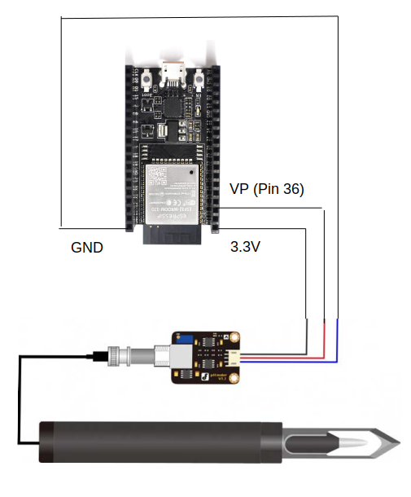
Step 3 : Connecting Hardware
We initially chose to connect to 5V, but due to some excessive electrical noise, the code was not being uploaded onto the microcontroller board, hence we shifted it to 3.3V through which it worked smoothly.
Pin 36 is an analog input pin.
CONNECTIONS

Slide 6
Step 4: Code Modifications
Wifi Reset:
In order to take care of the wifi reset problem, we added an if condition in the main loop to check if the wifi is connected at each iteration. If not, the program resets and runs through the wifi setup process again

Slide 7
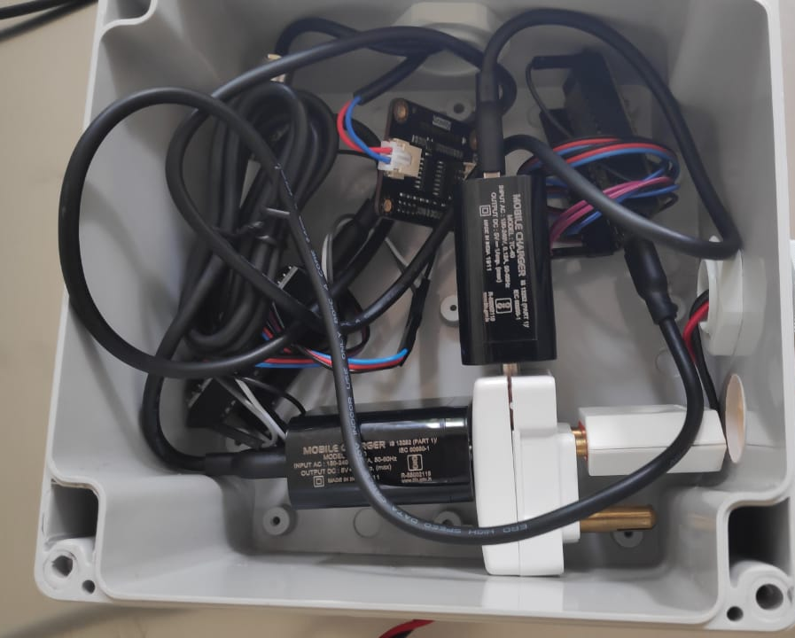
Step 5 : Bringing it together
We rolled up all the wires, collaborated with another team and packed all our components into a box for safe and dry deployement

Slide 8
Step 5 Continuation...
1. Each microcontroller was connected to a charger
2. Each charger was connected to a single female to male connector
3. This connector connected to another female to male connector which was connected to the main wire(which would be plugged into the wall for power)

Slide 9
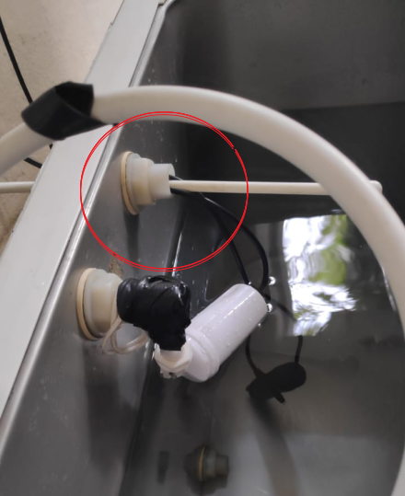
Step 6 : Deployment
We found a water tank in Nilgiri.
We put both sensors in the water tank and pulled the wires out through the same hole through which the filtered water
entered
the tank

Slide 10
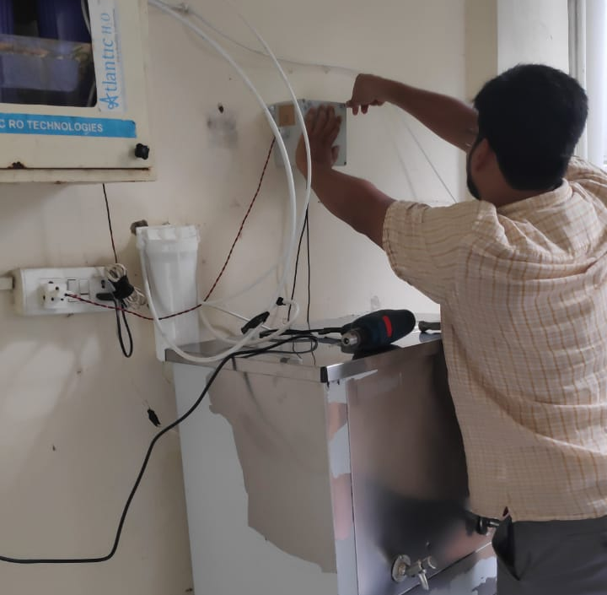
Step 6 Continuation...
Once we successfully placed the sensors, we mounted the box containing the microcontrollers and other electrical connections onto the wall using a drilling machine

Slide 11
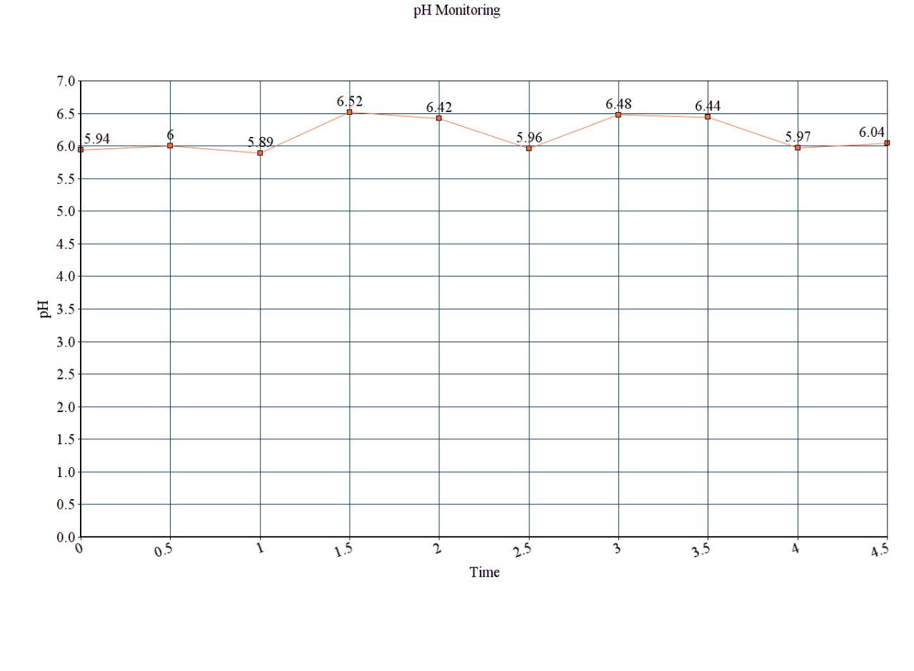
Data on the Server
Beginning data points

Slide 12
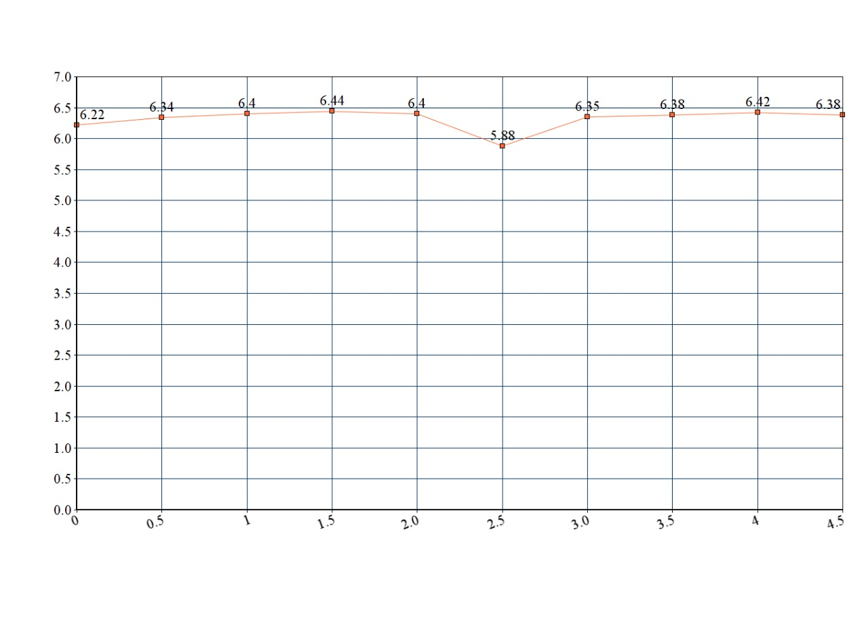
Data on the Server
Final data points

Slide 13
Conclusions Drawn
1. In the beginning there appears to be a lot of fluctuation in the detected pH between 5.8 and 6.5. This happens anytime the sensor is placed in a new solution
2. However towards the end it is seen that the pH value stabilized around 6.4
3. From this we can conclude that the water filter was doing a decent job at keeping the water within the safe drinking water pH range(6-8.5)

